Slide 1
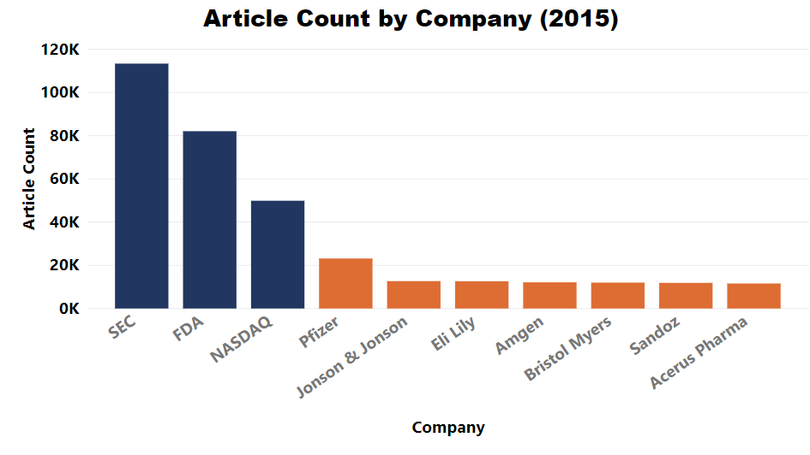
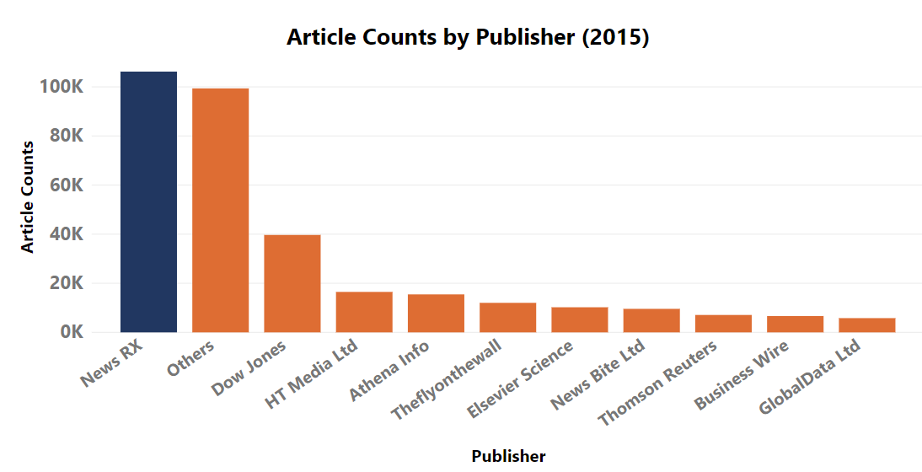

Detecting Pharmaceutical Innovations in News Articles using Machine Learning
DSPG: Quinton Neville (Columbia University), Raghav Sawhney (Virginia Tech) SDAD: Devika Nair, Gizem Korkmaz, Neil Alexander Kattampallil
Background – Quinton
Research Questions
OSLO definition of innovation
Impact of innovation
Stakeholder – NCSES - Innovation
Data - Raghav
Sources
Manipulation/Generation (doc term matrices)
Sampling - 50/50 vs. varying proportions
Profile – figures by Raghav
Most mentioned companies/ products
Network map – company mention map
Year distribution of articles
Dictionary method (strict filter, company names)
Labeling – survey
Approach – Quinton
Subject Code – New Product – Labeled data
Raw Data
ML Techniques: Quinton
Supervised – Bag of Words, SVM, Neural Nets, LDA-Predictive
Unsupervised – LDA
------
Figures – get HEX from website – work
ROC plots for multiple methods on same figure
Table of Accuracy & AOC
For final model – distribution of accuracy
Results
ROC
Validation of accuracy - Boot Strapping – test set - distribution of accuracy, resample, refit multiple times, mimics sampling
Diagnostic tool - 10 fold CV – training set to fit the model - not good with small sets
Question for Josh! CV vs. Booststrapping
Think about/ explain More:
Tie back to research question! What is the pipeline – DN
What a company does:
pharma > clinical studies > FDA >> market launch
What we’re doing
-------------- detecting innovation --------------------------
------BRDIS ---------
BRDIS – per industry per company innovation
Weighted by company features (size, activity, etc)
Conclusion
SOCIAL AND DECISION ANALYTICS
BACKGROUND
Corporate innovation directly correlates to the welfare of the national economy, and for that reason, the National Center for Science and Engineering Statistics (NCSES) sponsors the annual Business R&D and Innovation Survey (BRDIS) to measure the incidence of innovation from companies directly.
Research & Development
FDA Application & Approval
Market Launch
Financial Reports
During the three years 2013 to 2015, did your company introduce:
a. New or significantly improved goods (Exclude the simple resale of new
goods purchased from other companies and changes of a solely
aesthetic nature)? … …………………………………………………….... ❑ Yes ❑ No
b. New or significantly improved services? ………………………………… ❑ Yes ❑ No
8
The project narrows focus to the pharmaceutical industry, for a number of reasons:
strict regulation of new products (drugs and medical devices)
frequent and consistent release of new products
availability of data
The aim of this project is to develop a machine learning method by which innovation could be identified by predicts whether or not an article describes innovation, as given by the development of new drugs or medical devices.
Subhead - Franklin Gothic Demi - 28
Body Text - Franklin Gothic Book - 22
This work utilizes the OSLO Manual definition of innovation, which requires two key criteria:
Product must be new or significantly improved
Product must be available on the market
The project seeks to enrich and complement the BRDIS innovation measures by leveraging alternative text-based sources to detect innovation in the news.
DATA
About 2 million articles about the pharmaceutical industry across years 2013-2018 were purchased from the media conglomerate, Dow Jones. The DNA data product furnishes over 30 variables of interest on these articles, including publisher, subject, company codes, and publication date. The data was profiled (see Figures X & Y), subselected, cleaned, and converted into document matrices via the bag-of-words method. The outcome of interest used here for modeling was:
C22 – DNA generated subject tag indicating “New Products/Services”
Survey-generated manually labeled article set
Figure #1. Top DNA companies
Figure #2. Publisher distribution
METHODS & RESULTS
We implemented the following supervised models:
Penalized Generalized Linear Model Logistic regression generating predicted probabilities for a binary classifier, parametric (Binomial Distribution), with penalization and shrinkage parameters to adjust for number of features (words in articles).
Random Forest Builds a bootstrapped bag or "forest" of independent decision trees, optimizing the both depth and number of trees, averages the results for a robust probability threshold for a binary classifier.
Gradiant Boosting Machine (Trees) Similar to random forest, however the bag of trees being built is not independent; rather each tree is built based on the performance of the previous one, allowing for a learning rate as the forest grows. Same outcome as random forest.
Neural Network Extremely flexible network of interconnected nodes, performing gradient descent linear models between nodes, to create probablistically likely paths through the network of features ultimately leading to a probability threshold for binary classification.
Things that could go here?
BERT (could go in future steps
Cost calculations/confusion matrix
ROC
Cost graph
Violin graph
Figure #2
CONCLUSIONS
Background background text text text
Background background text text text
References
THIS SECTION COULD INCLUDE:
OSLO
BRDIS
BERT paper
FDA approvals
Machine learning papers? The ones sent to Gary LDA?

